Slide 1
We will cover these parts of the book (8th edition): 2.1 2.2.1-2.2.3 2.3 2.4.1, 2.4.2, 2.4.5

Slide 2
Set Theory
Set: Collection of objects (“elements/members”)
a∈A “a is an element of A” “a is a member of A”
a∉A “a is not an element of A”
A = {a₁, a₂, …, a_{n}} “A contains…” (roster method)
Order of elements is meaningless
It does not matter how often the same element is listed. (generally there are no repetitions)

Slide 3
Examples for Sets
“Standard” Sets:
Natural numbers N = {0, 1, 2, 3, …}
Integers Z = {…, -2, -1, 0, 1, 2, …}
Positive Integers Z⁺ = {1, 2, 3, 4, …}
Real Numbers R = {47.3, -12, π, …}
Rational Numbers Q = {1.5, 2.6, -3.8, 15, …}
Positive Real Numbers R⁺
Complex Numbers C (correct definitions will follow)

Slide 4
Examples for Sets
A = ∅ “empty set/null set”
A = {z} “singleton set” Note: z∈A, but z ≠ {z}
A = {{b, c}, {c, x, d}}
A = {{x, y}} Note: {x, y} ∈A, but {x, y} ≠ {{x, y}}
A = {x | P(x)} “set of all x such that P(x)”
A = {x | x∈N ∧ x > 7} = {8, 9, 10, …} “set builder notation”

Slide 5
Examples for Sets
We are now able to define the set of rational numbers Q:
Q = {a/b | a∈Z ∧ b∈Z⁺}
or
Q = {a/b | a∈Z ∧ b∈Z ∧ b≠0}
And how about the set of real numbers R?
R = {r | r is a real number} That is the best we can do.

Slide 6
Subsets
A ⊆ B “A is a subset of B”
A ⊆ B if and only if every element of A is also an element of B.
We can completely formalize this:
A ⊆ B ⇔ ∀x (x∈A → x∈B)
Examples:
A = {3, 9}, B = {5, 9, 1, 3}, A $⊆$ B ?
true
A = {3, 3, 3, 9}, B = {5, 9, 1, 3}, A $⊆$ B ?
true
A = {1, 2, 3}, B = {2, 3, 4}, A $⊆$ B ?
false

Slide 7
Subsets
Useful rules:
A = B ⇔ (A ⊆ B) ∧ (B ⊆ A)
(A ⊆ B) ∧ (B ⊆ C) ⇒ A ⊆ C (see Venn Diagram)
U
B
A
C

Slide 8
Subsets
Useful rules:
∅ ⊆ A for any set A
A ⊆ A for any set A
Proper subsets:
A ⊂ B “A is a proper subset of B”
A ⊂ B ⇔ ∀x (x∈A → x∈B) ∧ ∃x (x∈B ∧ x∉A)
or
A ⊂ B ⇔ ∀x (x∈A → x∈B) ∧ ¬∀x (x∈B → x∈A)

Slide 9
Set Equality
Sets A and B are equal if and only if they contain exactly the same elements. $∀x(x∈A↔x∈B)$ or $(A⊆B)∧(B⊆A)$
Examples:
A = {9, 2, 7, -3}, B = {7, 9, -3, 2} :
A = B
A = {dog, cat, horse}, B = {cat, horse, squirrel, dog} :
A $≠$ B
A = {dog, cat, horse}, B = {cat, horse, dog, dog} :
A = B

Slide 10
Cardinality of Sets
If a set S contains n distinct elements, n∈N, we call S a finite set with cardinality n.
Examples:
A = {Mercedes, BMW, Porsche}, |A| = 3
B = {1, {2, 3}, {4, 5}, 6}
|B| = 4
C = $∅$
|C| = 0
D = { x$∈$N | x $≤$ 7000 }
|D| = 7001
E = { x$∈$N | x $>$ 7000 }
E is infinite!

Slide 11
The Power Set
2^{A} or P(A) “power set of A”
2^{A} = {B | B ⊆ A} (contains all subsets of A)
Examples:
A = {x, y, z}
2^{A} = {∅, {x}, {y}, {z}, {x, y}, {x, z}, {y, z}, {x, y, z}}
A = ∅
2^{A} = {∅}
Note: |A| = 0, |2^{A}| = 1

Slide 12
The Power Set
Cardinality of power sets:
| 2^{A} | = 2^{|A|}
Imagine each element in A has an “on/off” switch
Each possible switch configuration in A corresponds to one element in 2^{A}
A | 1 | 2 | 3 | 4 | 5 | 6 | 7 | 8
x | x | x | x | x | x | x | x | x
y | y | y | y | y | y | y | y | y
z | z | z | z | z | z | z | z | z
For 3 elements in A, there are 2x2x2 = 8 elements in 2^{A}

Slide 13
Cartesian Product
The ordered n-tuple (a₁, a₂, a₃, …, a_{n}) is an ordered collection of objects.
Two ordered n-tuples (a₁, a₂, a₃, …, a_{n}) and (b₁, b₂, b₃, …, b_{n}) are equal if and only if they contain exactly the same elements in the same order, i.e., a_{i} = b_{i} for 1 ≤ i ≤ n.
The Cartesian product of two sets is defined as:
A×B = {(a, b) | a∈A ∧ b∈B}
Example: A = {x, y}, B = {a, b, c} A×B = {(x, a), (x, b), (x, c), (y, a), (y, b), (y, c)}

Slide 14
Cartesian Product
Note that:
A×∅ = ∅
∅×A = ∅
For non-empty sets A and B: A≠B ⇔ A×B ≠ B×A
|A×B| = |A|⋅|B|
The Cartesian product of two or more sets is defined as:
A₁×A₂×…×A_{n} = {(a₁, a₂, …, a_{n}) | a_{i}∈A_{i} for 1 ≤ i ≤ n}

Slide 15
Partitions
Definition: A partition of a set S is a collection of disjoint nonempty subsets of S that have S as their union. In other words, the collection of subsets A_{i}, i∈I, forms a partition of S if and only if
(i) A_{i} ≠ ∅ for i∈I
A_{i} ∩ A_{j} = ∅, if i ≠ j
∪_{i∈I} A_{i} = S

Slide 16
Partitions
Examples: Let S be the set {u, m, b, r, o, c, k, s}. Do the following collections of sets partition S ?
{{m, o, c, k}, {r, u, b, s}}
yes.
{{c, o, m, b}, {u, s}, {r}}
no (k is missing).
{{b, r, o, c, k}, {m, u, s, t}}
no (t is not in S).
{{u, m, b, r, o, c, k, s}}
yes.
{{b, o, r, k}, {r, u, m}, {c, s}}
no (r is in two sets).
{{u, m, b}, {r, o, c, k, s}, $∅$}
no ($∅$ not allowed).

Slide 17
Set Operations
Union: A∪B = {x | x∈A ∨ x∈B}
Example: A = {a, b}, B = {b, c, d}
A∪B = {a, b, c, d}
$\left|A∪B\right|=\left|A\right|+\left|B\right|−|A∩B|$
Intersection: A∩B = {x | x∈A ∧ x∈B}
Example: A = {a, b}, B = {b, c, d}
A∩B = {b}

Slide 18
Set Operations
Two sets are called disjoint if their intersection is empty, that is, they share no elements:
A∩B = ∅
The difference between two sets A and B contains exactly those elements of A that are not in B:
A-B = {x | x∈A ∧ x∉B} Example: A = {a, b}, B = {b, c, d}, A-B = {a}

Slide 19
Set Operations
The complement of a set A contains exactly those elements under consideration that are not in A:
-A = U-A
Example: U = N, B = {250, 251, 252, …}
-B = {0, 1, 2, …, 248, 249}
$A−B=A∩\overline{B}$

Slide 20
Set Operations
How can we prove A∪(B∩C) = (A∪B)∩(A∪C)?
Method I:
x∈A∪(B∩C)
x∈A ∨ x∈(B∩C)
x∈A ∨ (x∈B ∧ x∈C)
(x∈A ∨ x∈B) ∧ (x∈A ∨ x∈C) (distributive law for logical expressions)
x∈(A∪B) ∧ x∈(A∪C)
x∈(A∪B)∩(A∪C)

Slide 21
Set Operations
Method II: Membership table
1 means “x is an element of this set” 0 means “x is not an element of this set”
A B C | B∩C | A∪(B∩C) | A∪B | A∪C | (A∪B) ∩(A∪C)
0 0 0 | 0 | 0 | 0 | 0 | 0
0 0 1 | 0 | 0 | 0 | 1 | 0
0 1 0 | 0 | 0 | 1 | 0 | 0
0 1 1 | 1 | 1 | 1 | 1 | 1
1 0 0 | 0 | 1 | 1 | 1 | 1
1 0 1 | 0 | 1 | 1 | 1 | 1
1 1 0 | 0 | 1 | 1 | 1 | 1
1 1 1 | 1 | 1 | 1 | 1 | 1

Slide 22
Set Identities
Identity | Name
$$A∩U=A$$ $$A∪∅=A$$ | Identity laws
$$A∪U=U$$ $$A∩∅=∅$$ | Domination laws
$$A∪A=A$$ $$A∩A=A$$ | Idempotent laws
$$\overline{(\overline{A})}=A$$ | Complementation laws
$$A∪B=B∪A$$ $$A∩B=B∩A$$ | Commutative laws
Identity | Name
$$A∪\left(B∪C\right)=\left(A∪B\right)∪C$$ $$A∩\left(B∩C\right)=\left(A∩B\right)∩C$$ | Associative laws
$$A∪\left(B∩C\right)=\left(A∪B\right)∩(A∪C)$$ $$A∩\left(B∪C\right)=\left(A∩B\right)∪(A∩C)$$ | Distributive laws
$$\overline{\left(A∩B\right)}=\overline{A}∪\overline{B}$$ $$\overline{\left(A∪B\right)}=\overline{A}∩\overline{B}$$ | De Morgan’s laws
$$A∪\left(A∩B\right)=A$$ $$A∩\left(A∪B\right)=A$$ | Absorption laws
$$A∪\overline{A}=U$$ $$A∩\overline{A}=∅$$ | Complement laws

Slide 23
Proving Set Identities
Description | Method
Subset method | Show that each side of the identity is a subset of the other side.
Membership table | For each possible combination of the atomic sets, show that an element in exactly these atomic sets must either belong to both sides or belong to neither side.
Apply existing identities | Start with one side, transform it into the other side using a sequence of steps by applying an established identity.

Slide 24
Exercises
Question 1:
Given a set A = {x, y, z} and a set B = {1, 2, 3, 4}, what is the value of | 2^{A} × 2^{B} | ?
Question 2:
Is it true for all sets A and B that (A×B)∩(B×A) = ∅ ? Or do A and B have to meet certain conditions?
Question 3:
For any two sets A and B, if A – B = ∅ and B – A = ∅, can we conclude that A = B? Why or why not?

Slide 25
Exercises
Question 1:
Given a set A = {x, y, z} and a set B = {1, 2, 3, 4}, what is the value of | 2^{A} × 2^{B} | ?
Answer:
| 2^{A} × 2^{B} | = | 2^{A} | ⋅ | 2^{B} | = 2^{|A|} ⋅ 2^{|B|} = 8⋅16 = 128

Slide 26
Exercises
Question 2:
Is it true for all sets A and B that (A×B)∩(B×A) = ∅ ? Or do A and B have to meet certain conditions?
Answer:
If A and B share at least one element x, then both (A×B) and (B×A) contain the pair (x, x) and thus are not disjoint.
Therefore, for the above equation to be true, it is necessary that A∩B = ∅.

Slide 27
Exercises
Question 3:
For any two sets A and B, if A – B = ∅ and B – A = ∅, can we conclude that A = B? Why or why not?
Answer:
Proof by contradiction: Assume that A ≠ B.
Then there must be either an element x such that x∈A and x∉B or an element y such that y∈B and y∉A.
If x exists, then x∈(A – B), and thus A – B ≠ ∅.
If y exists, then y∈(B – A), and thus B – A ≠ ∅.
This contradicts the premise A – B = ∅ and B – A = ∅, and therefore we can conclude A = B.

Slide 28
… and the next section is about…
Functions

Slide 29
Functions
A function f from a set A to a set B is an assignment of exactly one element of B to each element of A.
We write
f(a) = b
if b is the unique element of B assigned by the function f to the element a of A.
If f is a function from A to B, we write
f: A→B
(note: Here, “→“ has nothing to do with if… then)

Slide 30
Functions
If f:A→B, we say that A is the domain of f and B is the codomain of f.
If f(a) = b, we say that b is the image of a and a is the pre-image of b.
The range of f:A→B is the set of all images of elements of A.
We say that f:A→B maps A to B.

Slide 31
Functions
Let us take a look at the function f:P→C with
P = {Linda, Max, Kathy, Peter}
C = {Boston, New York, Hong Kong, Moscow}
f(Linda) = Moscow
f(Max) = Boston
f(Kathy) = Hong Kong
f(Peter) = New York
Here, the range of f is C.

Slide 32
Functions
Let us re-specify f as follows:
f(Linda) = Moscow
f(Max) = Boston
f(Kathy) = Hong Kong
f(Peter) = Boston
Is f still a function?
yes
What is its range?
{Moscow, Boston, Hong Kong}

Slide 33
Functions
Other ways to represent f:
x | f(x)
Linda | Moscow
Max | Boston
Kathy | Hong Kong
Peter | Boston
Linda
Boston
Max
New York
Kathy
Hong Kong
Peter
Moscow

Slide 34
Functions
If the domain of our function f is large, it is convenient to specify f with a formula, e.g.:
f:R→R
f(x) = 2x
This leads to:
f(1) = 2
f(3) = 6
f(-3) = -6
…

Slide 35
Functions
Let f₁ and f₂ be functions from A to R.
Then the sum and the product of f₁ and f₂ are also functions from A to R defined by:
(f₁ + f₂)(x) = f₁(x) + f₂(x)
(f₁f₂)(x) = f₁(x) f₂(x)
Example:
f₁(x) = 3x, f₂(x) = x + 5
(f₁ + f₂)(x) = f₁(x) + f₂(x) = 3x + x + 5 = 4x + 5
(f₁f₂)(x) = f₁(x) f₂(x) = 3x (x + 5) = 3x² + 15x

Slide 36
Functions
We already know that the range of a function f:A→B is the set of all images of elements a∈A.
If we only regard a subset S⊆A, the set of all images of elements s∈S is called the image of S.
We denote the image of S by f(S):
f(S) = {f(s) | s∈S}

Slide 37
Functions
Let us look at the following well-known function:
f(Linda) = Moscow
f(Max) = Boston
f(Kathy) = Hong Kong
f(Peter) = Boston
What is the image of S = {Linda, Max} ?
f(S) = {Moscow, Boston}
What is the image of S = {Max, Peter} ?
f(S) = {Boston}

Slide 38
Properties of Functions
A function f:A→B is said to be one-to-one (or injective), if and only if
∀x, y∈A (f(x) = f(y) → x = y)
In other words: f is one-to-one if and only if it does not map two distinct elements of A onto the same element of B.
Note that a function $f$is one-to-one if and only if $f(a)≠f(b)$ whenever$a ≠ b$. This way of expressing that $f$is one-to-one is obtained by taking the contrapositive of the implication in the definition.

Slide 39
Properties of Functions
And again…
f(Linda) = Moscow
f(Max) = Boston
f(Kathy) = Hong Kong
f(Peter) = Boston
Is f one-to-one?
No, Max and Peter are mapped onto the same element of the image.
g(Linda) = Moscow
g(Max) = Boston
g(Kathy) = Hong Kong
g(Peter) = New York
Is g one-to-one?
Yes, each element is assigned a unique element of the image.

Slide 40
Properties of Functions
How can we prove that a function f is one-to-one?
Whenever you want to prove something, first take a look at the relevant definition(s):
∀x, y∈A (f(x) = f(y) → x = y)
Example:
f:R→R
f(x) = x²
Disproof by counterexample:
f(3) = f(-3), but 3 ≠ -3, so f is not one-to-one.

Slide 41
Properties of Functions
… and yet another example:
f:R→R
f(x) = 3x
One-to-one: ∀x, y∈A (f(x) = f(y) → x = y)
To show: f(x) ≠ f(y) whenever x ≠ y
x ≠ y
3x ≠ 3y
f(x) ≠ f(y),
so if x ≠ y, then f(x) ≠ f(y), that is, f is one-to-one.

Slide 42
Properties of Functions
A function f:A→B with A,B ⊆ R is called increasing, if $x,yA (x<y  f(x)≤f(y)),$ and strictly increasing, if$x,y∈A \left(x<y → f\left(x\right)<f\left(y\right)\right).$
f is decreasing if $x,y∈A (x<y → f\left(x\right)≥f(y))$, and strictly decreasing if
$x,y∈A (x<y → f\left(x\right)>f(y))$
Obviously, a function that is either strictly increasing or strictly decreasing is one-to-one.

Slide 43
Properties of Functions
A function f:A→B is called onto, or surjective, if and only if for every element b∈B there is an element a∈A with f(a) = b.
In other words, f is onto if and only if its range is its entire codomain.
A function f: A→B is a one-to-one correspondence, or a bijection, if and only if it is both one-to-one and onto.
Obviously, if f is a bijection and A and B are finite sets, then |A| = |B|.

Slide 44
Properties of Functions
Examples:
In the following examples, we use the arrow representation to illustrate functions f:A→B.
In each example, the complete sets A and B are shown.

Slide 45
Properties of Functions

Slide 46
Properties of Functions
Linda
Boston
Is f injective?
No.
Is f surjective?
No.
Is f bijective?
No.
Max
New York
Kathy
Hong Kong
Peter
Moscow

Slide 47
Properties of Functions
Linda
Boston
Is f injective?
No.
Is f surjective?
Yes.
Is f bijective?
No.
Max
New York
Kathy
Hong Kong
Peter
Moscow
Paul

Slide 48
Properties of Functions
Linda
Boston
Is f injective?
Yes.
Is f surjective?
No.
Is f bijective?
No.
Max
New York
Kathy
Hong Kong
Peter
Moscow
Lübeck

Slide 49
Properties of Functions
Linda
Boston
Is f injective?
No! f is not even a function!
Max
New York
Kathy
Hong Kong
Peter
Moscow
Lübeck

Slide 50
Properties of Functions
Linda
Boston
Is f injective?
Yes.
Is f surjective?
Yes.
Is f bijective?
Yes.
Max
New York
Kathy
Hong Kong
Peter
Moscow
Helena
Lübeck

Slide 51
Inversion
An interesting property of bijections is that they have an inverse function.
The inverse function of the bijection f:A→B is the function f⁻¹:B→A with
f⁻¹(b) = a whenever f(a) = b.

Slide 52
Inversion
Linda
Boston
f
Max
New York
f⁻¹
Kathy
Hong Kong
Peter
Moscow
Helena
Lübeck

Slide 53
Inversion
Example:
f(Linda) = Moscow
f(Max) = Boston
f(Kathy) = Hong Kong
f(Peter) = Lübeck
f(Helena) = New York
Clearly, f is bijective.
The inverse function f⁻¹ is given by:
f⁻¹(Moscow) = Linda
f⁻¹(Boston) = Max
f⁻¹(Hong Kong) = Kathy
f⁻¹(Lübeck) = Peter
f⁻¹(New York) = Helena
Inversion is only possible for bijections (= invertible functions)

Slide 54
Inversion
Linda
Boston
f
Max
New York
f⁻¹
f⁻¹:C→P is no function, because it is not defined for all elements of C and assigns two images to the pre-image New York.
Kathy
Hong Kong
Peter
Moscow
Helena
Lübeck

Slide 55
Composition
The composition of two functions g:A→B and f:B→C, denoted by f°g, is defined by
(f°g)(a) = f(g(a))
This means that
first, function g is applied to element a∈A, mapping it onto an element of B,
then, function f is applied to this element of B, mapping it onto an element of C.
Therefore, the composite function maps from A to C.

Slide 56
Composition
Example:
f(x) = 7x – 4, g(x) = 3x,
f:R→R, g:R→R
(f°g)(5) = f(g(5)) = f(15) = 105 – 4 = 101
(f°g)(x) = f(g(x)) = f(3x) = 21x - 4

Slide 57
Composition
Composition of a function and its inverse:
(f⁻¹°f)(x) = f⁻¹(f(x)) = x
The composition of a function and its inverse is the identity function i(x) = x.

Slide 58
Graphs
The graph of a function f:A→B is the set of ordered pairs {(a, b) | a∈A and f(a) = b}.
The graph is a subset of A×B that can be used to visualize f in a two-dimensional coordinate system.
From the definition, the graph of a function $f$ from $A$ to $B$ is the subset of $A×B$ containing the ordered pairs with the second entry equal to the element of $B$ assigned by f to the first entry.

Slide 59
Floor and Ceiling Functions
The floor and ceiling functions map the real numbers onto the integers (R→Z).
The floor function assigns to r∈R the largest z∈Z with z≤r, denoted by ⎣r⎦.
Examples: ⎣2.3⎦ = 2, ⎣2⎦ = 2, ⎣0.5⎦ = 0, ⎣-3.5⎦ = -4
The ceiling function assigns to r∈R the smallest z∈Z with z≥r, denoted by ⎡r⎤.
Examples: ⎡2.3⎤ = 3, ⎡2⎤ = 2, ⎡0.5⎤ = 1, ⎡-3.5⎤ = -3

Slide 60
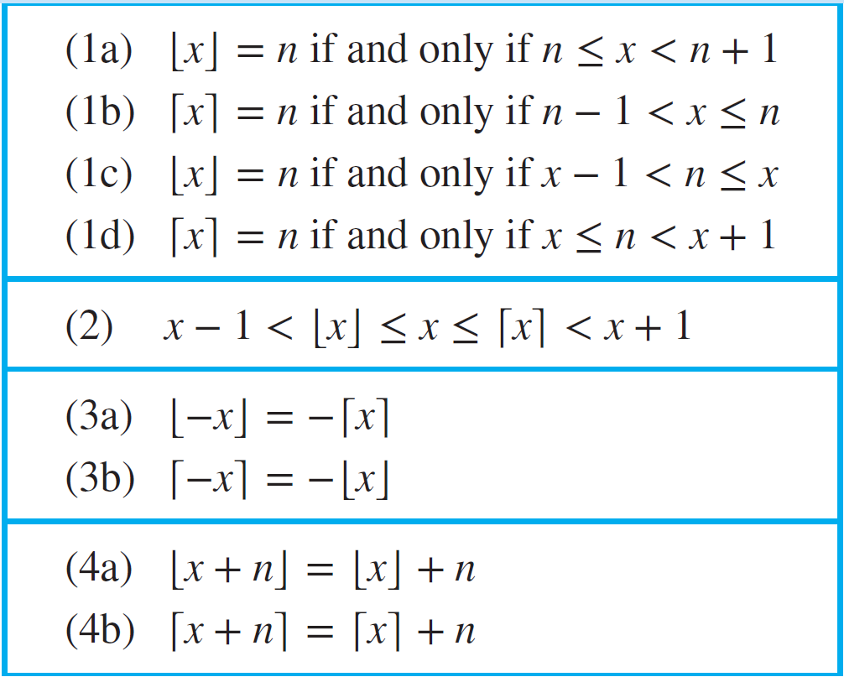
Floor and Ceiling Functions
Useful properties of the Floor and Ceiling functions ($n$ is an integer and $x$ is a real number)

Slide 61
Sequences
Sequences represent ordered lists of elements.
A sequence is defined as a function from a subset of N to a set S. We use the notation a_{n} to denote the image of the integer n. We call a_{n} a term of the sequence.
Example:
subset of N: 1 2 3 4 5 …
S: 2 4 6 8 10 …

Slide 62
Sequences
We use the notation {a_{n}} to describe a sequence.
Important: Do not confuse this with the {} used in set notation.
It is convenient to describe a sequence with an equation.
For example, the sequence on the previous slide can be specified as {a_{n}}, where a_{n} = 2n.

Slide 63
The Equation Game
What are the equations that describe the following sequences a₁, a₂, a₃, … ?
1, 3, 5, 7, 9, …
a_{n} = 2n - 1
-1, 1, -1, 1, -1, …
a_{n} = (-1)^{n}
2, 5, 10, 17, 26, …
a_{n} = n² + 1
0.25, 0.5, 0.75, 1, 1.25 …
a_{n} = 0.25n
3, 9, 27, 81, 243, …
a_{n} = 3^{n}

Slide 64
Strings
Finite sequences are also called strings, denoted by a₁a₂a₃…a_{n}.
The length of a string S is the number of terms that it consists of.
The empty string contains no terms at all. It has length zero.

Slide 65
Summations
What does $\sum_{j=m}^{n}{a_{j}}$ stand for?
It represents the sum a_{m} + a_{m+1} + a_{m+2} + … + a_{n}.
The variable j is called the index of summation, running from its lower limit m to its upper limit n. We could as well have used any other letter to denote this index.

Slide 66
Geometric and Arithmetic progressions
The sequence $a,ar,ar^{2},…,ar^{n},…$ is a geometric progression where the initial term $a$ and the common ratio $r$ are real numbers.
The sequence $a,a+d,a+2d,…,a+nd,…$ is a arithmetic progression where the initial term $a$ and the common difference d are real numbers.

Slide 67
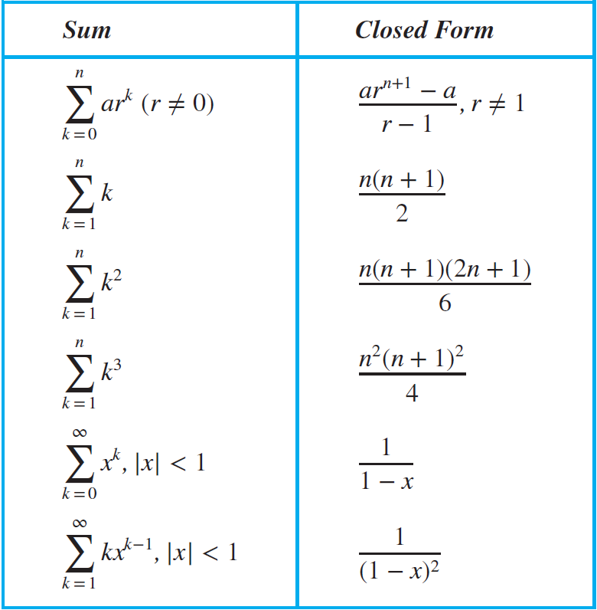
Some useful Summation Formulae

Slide 68
Summations
How can we express the sum of the first 1000 terms of the sequence {a_{n}} with a_{n}=n² for n = 1, 2, 3, … ?
We write it as $\sum_{j=1}^{1000}{j^{2}}$
What is the value of ?
It is 1 + 2 + 3 + 4 + 5 + 6 = 21.
What is the value of ?
It is so much work to calculate this…

Slide 69
Summations
It is said that Carl Friedrich Gauss came up with the following formula:
When you have such a formula, the result of any summation can be calculated much more easily, for example:

Slide 70
Double Summations
Corresponding to nested loops in C or Java, there is also double (or triple etc.) summation. To evaluate the double sum, first expand the inner summation and then continue by computing the outer summation:
Example:
$\sum_{i=1}^{4}{\sum_{j=1}^{3}{ij=}\sum_{i=1}^{4}{\left(i+2i+3i\right)=\sum_{i=1}^{4}{6i}=6∗\frac{4∗5}{2}=60}}$

