Slide 1
We will cover these parts of the book (8th edition): 2.6 3.1.1-3.1.3 (up to page 207) 3.2.1-3.2.4 3.3.1, 3.3.2

Slide 2
Matrices
A matrix is a rectangular array of numbers.
A matrix with m rows and n columns is called an m×n matrix.
Example:
is a 3x2 matrix
A matrix with the same number of rows and columns is called square.
Two matrices are equal if they have the same number of rows and columns and the corresponding entries in every position are equal.

Slide 3
Matrices
A general description of an m×n matrix A = [a_{ij}]:
j-th column of A
i-th row of A

Slide 4
Matrix Addition
Let A = [a_{ij}] and B = [b_{ij}] be m×n matrices.
The sum of A and B, denoted by A+B, is the m×n matrix that has a_{ij} + b_{ij} as its (i, j)th element.
In other words, A+B = [a_{ij} + b_{ij}].
Example:

Slide 5
Matrix Multiplication
Let A be an m×k matrix and B be a k×n matrix.
The product of A and B, denoted by AB, is the m×n matrix with (i, j)th entry equal to the sum of the products of the corresponding elements from the i-th row of A and the j-th column of B.
In other words, if AB = [c_{ij}], then

Slide 6
Matrix Multiplication
A more intuitive description of calculating C = AB:
- Take the first column of B
Turn it counterclockwise by 90 degrees and superimpose it on the first row of A
Multiply corresponding entries in A and B and add the products: 3x2 + 0x0 + 1x3 = 9
Enter the result in the upper-left corner of C

Slide 7
Matrix Multiplication
Now superimpose the first column of B on the second, third, …, m-th row of A to obtain the entries in the first column of C (same order).
Then repeat this procedure with the second, third, …, n-th column of B, to obtain to obtain the remaining columns in C (same order).
After completing this algorithm, the new matrix C contains the product AB.

Slide 8
Matrix Multiplication
Let us calculate the complete matrix C:
9
7
8
15
15
20
-2
-2

Slide 9
Identity Matrices
The identity matrix of order n is the n×n matrix I_{n} = [δ_{ij}], where δ_{ij} = 1 if i = j and δ_{ij} = 0 if i ≠ j:
Multiplying an mxn matrix A by an identity matrix of appropriate size does not change this matrix:
AI_{n} = I_{m}A = A

Slide 10
Powers and Transposes of Matrices
The power function can be defined for square matrices. If A is an n×n matrix, we have:
A⁰ = I_{n},
A^{r} = AAA…A (r times the letter A)
The transpose of an m×n matrix A = [a_{ij}], denoted by A^{t}, is the n×m matrix obtained by interchanging the rows and columns of A.
In other words, if A^{t} = [b_{ij}], then b_{ij} = a_{ji} for i = 1, 2, …, n and j = 1, 2, …, m.

Slide 11
Powers and Transposes of Matrices
Example:
A square matrix A is called symmetric if A = A^{t}.
Thus A = [a_{ij}] is symmetric if a_{ij} = a_{ji} for all i = 1, 2, …, n and j = 1, 2, …, n.
A is symmetric, B is not.

Slide 12
Zero-One Matrices
A matrix with entries that are either 0 or 1 is called a zero-one matrix. Zero-one matrices are often used like a “table” to represent discrete structures.
We can define Boolean operations on the entries in zero-one matrices:
a | b | a∧b
0 | 0 | 0
0 | 1 | 0
1 | 0 | 0
1 | 1 | 1
a | b | a∨b
0 | 0 | 0
0 | 1 | 1
1 | 0 | 1
1 | 1 | 1

Slide 13
Zero-One Matrices
Let A = [a_{ij}] and B = [b_{ij}] be m×n zero-one matrices.
Then the join of A and B is the zero-one matrix with (i, j)th entry a_{ij} ∨ b_{ij}. The join of A and B is denoted by A ∨ B.
The meet of A and B is the zero-one matrix with (i, j)th entry a_{ij} ∧ b_{ij}. The meet of A and B is denoted by A ∧ B.

Slide 14
Zero-One Matrices
Example:
Join:
Meet:

Slide 15
Zero-One Matrices
Let A = [a_{ij}] be an m×k zero-one matrix and B = [b_{ij}] be a k×n zero-one matrix.
Then the Boolean product of A and B, denoted by AοB, is the m×n matrix with (i, j)th entry [c_{ij}], where
c_{ij} = (a_{i1} ∧ b_{1j}) ∨ (a_{i2} ∧ b_{2i}) ∨ … ∨ (a_{ik} ∧ b_{kj}).
Note that the actual Boolean product symbol has a dot in its center.
Basically, Boolean multiplication works like the multiplication of matrices, but with computing ∧ instead of the product and ∨ instead of the sum.

Slide 16
Zero-One Matrices
Example:

Slide 17
Zero-One Matrices
Let A be a square zero-one matrix and r be a positive integer.
The r-th Boolean power of A is the Boolean product of r factors of A. The r-th Boolean power of A is denoted by A^{[r]}.
A^{[0]} = I_{n},
A^{[r]} = AοAο…οA (r times the letter A)

Slide 18
Algorithms

Slide 19
Algorithms
What is an algorithm?
An algorithm is a finite set of precise instructions for performing a computation or for solving a problem.
This is a rather vague definition. You will get to know a more precise and mathematically useful definition when you attend CS420 or CS620.
But this one is good enough for now…

Slide 20
Algorithms
Properties of algorithms:
Input from a specified set,
Output from a specified set (solution),
Definiteness of every step in the computation,
Correctness of output for every possible input,
Finiteness of the number of calculation steps,
Effectiveness of each calculation step and
Generality for a class of problems.

Slide 21
Algorithm Examples
We will use a pseudocode to specify algorithms, which slightly reminds us of Basic and Pascal.
Example: an algorithm that finds the maximum element in a finite sequence
procedure max(a₁, a₂, …, a_{n}: integers)
max := a₁
for i := 2 to n
if max < a_{i} then max := a_{i}
Return max{max is the largest element}

Slide 22
Algorithm Examples
Another example: a linear search algorithm, that is, an algorithm that linearly searches a sequence for a particular element.
procedure linear_search(x: integer; a₁, a₂, …, a_{n}: integers)
i := 1
while (i ≤ n and x ≠ a_{i})
i := i + 1
if i ≤ n then location := i
else location := 0
Return location{location is the subscript of the term that equals x, or is zero if x is not found}

Slide 23
Algorithm Examples
If the terms in a sequence are ordered, a binary search algorithm is more efficient than linear search.
The binary search algorithm iteratively restricts the relevant search interval until it closes in on the position of the element to be located.

Slide 24
Algorithm Examples
binary search for the letter ‘j’
search interval
a c d f g h j l m o p r s u v x z
center element

Slide 25
Algorithm Examples
binary search for the letter ‘j’
search interval
a c d f g h j l m o p r s u v x z
center element

Slide 26
Algorithm Examples
binary search for the letter ‘j’
search interval
a c d f g h j l m o p r s u v x z
center element

Slide 27
Algorithm Examples
binary search for the letter ‘j’
search interval
a c d f g h j l m o p r s u v x z
center element

Slide 28
Algorithm Examples
binary search for the letter ‘j’
search interval
a c d f g h j l m o p r s u v x z
center element
found !

Slide 29
Algorithm Examples
procedure binary_search(x: integer; a₁, a₂, …, a_{n}: integers)
i := 1 {i is left endpoint of search interval}
j := n {j is right endpoint of search interval}
while (i < j)
begin
m := ⎣(i + j)/2⎦
if x > a_{m} then i := m + 1
else j := m
end
if x = a_{i} then location := i
else location := 0
Return location{location is the subscript of the term that equals x, or is zero if x is not found}

Slide 30
Algorithm Examples
procedure bubblesort(a₁, a₂, …, a_{n}: real numbers, n$≥$2)
for i := 1 to n-1
for j := 1 to n-1
if $a_{j}>a_{j+1}$ then interchange $a_{j}$ and $a_{j+1}$
{a₁, a₂, …, a_{n} is in increasing order}

Slide 31
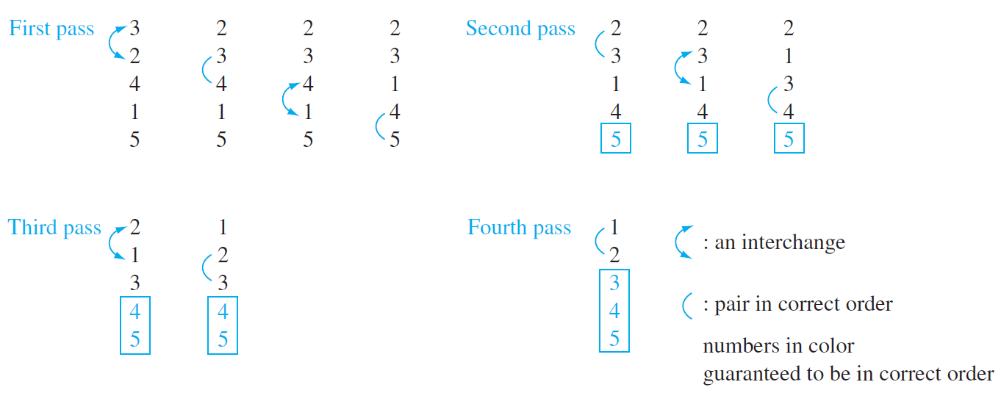
Algorithm Examples
Bubble sort:
It puts a list into increasing order by successively comparing adjacent elements, interchanging them if they are in the wrong order. To carry out the bubble sort, we perform the basic operation, that is, interchanging a larger element with a smaller one following it, starting at the beginning of the list, for a full pass. We iterate this procedure until the sort is complete.

Slide 32
The Growth of Functions
The growth of functions is usually described using the big-O notation.
Definition: Let f and g be functions from the integers or the real numbers to the real numbers.
We say that f(x) is O(g(x)) if there are constants C and k such that
|f(x)| ≤ C|g(x)|
whenever x > k.
This is read as “f(x) is big-oh of g(x)”

Slide 33
The Growth of Functions
When we analyze the growth of complexity functions, f(x) and g(x) are always positive.
Therefore, we can simplify the big-O requirement to
f(x) ≤ C⋅g(x) whenever x > k.
If we want to show that f(x) is O(g(x)), we only need to find one pair (C, k) (which is never unique).

Slide 34
The Growth of Functions
The idea behind the big-O notation is to establish an upper boundary for the growth of a function f(x) for large x.
This boundary is specified by a function g(x) that is usually much simpler than f(x).
We accept the constant C in the requirement
f(x) ≤ C⋅g(x) whenever x > k,
because C does not grow with x.
We are only interested in large x, so it is OK if f(x) > C⋅g(x) for x ≤ k.

Slide 35
The Growth of Functions
Example:
Show that f(x) = x² + 2x + 1 is O(x²).
For x > 1 we have:
x² + 2x + 1 ≤ x² + 2x² + x²
⇒ x² + 2x + 1 ≤ 4x²
Therefore, for C = 4 and k = 1:
f(x) ≤ Cx² whenever x > k.
⇒ f(x) is O(x²).

Slide 36
The Growth of Functions
Question: If f(x) is O(x²), is it also O(x³)?
Yes. x³ grows faster than x², so x³ grows also faster than f(x).
Therefore, we always have to find the smallest simple function g(x) for which f(x) is O(g(x)).
Let $f\left(x\right)=a_{n}x^{n}+a_{n−1}x^{n−1}+…+a_{1}x+a_{0}$, where $a_{0},a_{1},…,a_{n−1},a_{n}$ are real numbers. Then $f\left(x\right)$ is $O(x^{n})$

Slide 37
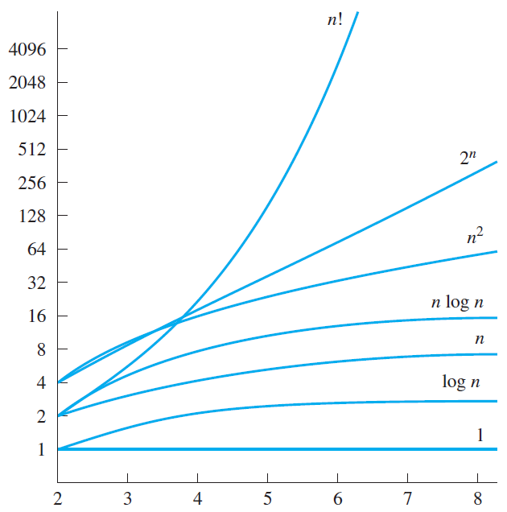
The Growth of Functions
“Popular” functions g(n) are
n log n, 1, 2^{n}, n², n!, n, n³, log n
Listed from slowest to fastest growth:
1
log n
n
n log n
n²
n³
2^{n}
n!

Slide 38
The Growth of Combinations of Functions
Suppose that $f_{1}(x)$ is $O\left(g_{1}\left(x\right)\right)$ and that $f_{2}(x)$ is $O\left(g_{2}\left(x\right)\right).$ Then ${(f}_{1}+f_{2})(x)$ is $O(g(x))$, where $g\left(x\right)=(max⁡(|g_{1}(x)|, |g_{2}(x)|))$ for all $x$.
Suppose that $f_{1}(x)$ is $O\left(g_{1}\left(x\right)\right)$ and that $f_{2}(x)$ is $O\left(g_{2}\left(x\right)\right).$ Then ${(f}_{1}f_{2})(x)$ is $O\left(g_{1}\left(x\right)g_{2}\left(x\right)\right)$.

Slide 39
Complexity of Algorithms
Obviously, on sorted sequences, binary search is more efficient than linear search.
How can we analyze the efficiency of algorithms?
We can measure the
time (number of elementary computations) and
space (number of memory cells) that the algorithm requires.
These measures are called time complexity and space complexity, respectively.

Slide 40
Time Complexity
The time complexity of an algorithm can be expressed in terms of the number of operations used by the algorithm when the input has a particular size.
Time complexity is described in terms of the number of operations required instead of actual computer time because of the difference in time needed for different computers to perform basic operations.

Slide 41
Time Complexity
What is the time complexity of the linear search algorithm?
We will determine the worst-case number of comparisons as a function of the number n of terms in the sequence.
By the worst-case performance of an algorithm, we mean the largest number of operations needed to solve the given problem.
The worst case for the linear algorithm occurs when the element to be located is not included in the sequence.
In that case, every item in the sequence is compared to the element to be located.

Slide 42
Algorithm Examples
Here is the linear search algorithm again:
procedure linear_search(x: integer; a₁, a₂, …, a_{n}: integers)
i := 1
while (i ≤ n and x ≠ a_{i})
i := i + 1
if i ≤ n then location := i
else location := 0
Return location{location is the subscript of the term that equals x, or is zero if x is not found}

Slide 43
Complexity
For n elements, the loop
while (i ≤ n and x ≠ a_{i}) i := i + 1
is processed n times, requiring 2n comparisons.
When it is entered for the (n+1)th time, only the comparison i ≤ n is executed and terminates the loop.
Finally, the comparison if i ≤ n then location := i is executed, so all in all we have a worst-case time complexity of 2n + 2.

Slide 44
Reminder: Binary Search Algorithm
procedure binary_search(x: integer; a₁, a₂, …, a_{n}: integers)
i := 1 {i is left endpoint of search interval}
j := n {j is right endpoint of search interval}
while (i < j)
begin
m := ⎣(i + j)/2⎦
if x > a_{m} then i := m + 1
else j := m
end
if x = a_{i} then location := i
else location := 0
Return location{location is the subscript of the term that equals x, or is zero if x is not found}

Slide 45
Complexity
What is the time complexity of the binary search algorithm?
Again, we will determine the worst-case number of comparisons as a function of the number n of terms in the sequence.
Let us assume there are n = 2^{k} elements in the list, which means that k = log n.
If n is not a power of 2, it can be considered part of a larger list, where 2^{k} < n < 2^{k+1}.

Slide 46
Complexity
In the first cycle of the loop
while (i < j)
begin
m := ⎣(i + j)/2⎦
if x > a_{m} then i := m + 1
else j := m
end
the search interval is restricted to 2^{k-1} elements, using two comparisons.

Slide 47
Complexity
In the second cycle, the search interval is restricted to 2^{k-2} elements, again using two comparisons.
This is repeated until there is only one (2⁰) element left in the search interval.
At this point 2k comparisons have been conducted.

Slide 48
Complexity
Then, the comparison
while (i < j)
exits the loop, and a final comparison
if x = a_{i} then location := i
determines whether the element was found.
Therefore, the overall time complexity of the binary search algorithm is 2k + 2 = 2 ⎡log n⎤ + 2.

Slide 49
Complexity
In general, we are not so much interested in the time and space complexity for small inputs.
For example, while the difference in time complexity between linear and binary search is meaningless for a sequence with n = 10, it is gigantic for n = 2³⁰.

Slide 50
Complexity
For example, let us assume two algorithms A and B that solve the same class of problems.
The time complexity of A is 5,000n, the one for B is ⎡1.1^{n}⎤ for an input with n elements.

Slide 51
Complexity
Comparison: time complexity of algorithms A and B
Input Size
Algorithm A
Algorithm B
n
5,000n
⎡1.1^{n}⎤
10
50,000
3
100
500,000
13,781
1,000
5,000,000
2.5x10⁴¹
1,000,000
5x10⁹
4.8x10⁴¹³⁹²

Slide 52
Complexity
This means that algorithm B cannot be used for large inputs, while running algorithm A is still feasible.
So what is important is the growth of the complexity functions.
The growth of time and space complexity with increasing input size n is a suitable measure for the comparison of algorithms.

Slide 53
The Growth of Functions
A problem that can be solved with polynomial worst-case complexity is called tractable.
Problems of higher complexity are called intractable.
Problems that no algorithm can solve are called unsolvable.
You will find out more about this in CS420.

Slide 54
Complexity Examples
What does the following algorithm compute?
procedure who_knows(a₁, a₂, …, a_{n}: integers)
who_knows := 0
for i := 1 to n-1
for j := i+1 to n
if |a_{i} – a_{j}| > who_knows then who_knows := |a_{i} – a_{j}|
{who_knows is the maximum difference between any two numbers in the input sequence}
Comparisons: n-1 + n-2 + n-3 + … + 1
= (n – 1)n/2 = 0.5n² – 0.5n
Time complexity is O(n²).

Slide 55
Complexity Examples
Another algorithm solving the same problem:
procedure max_diff(a₁, a₂, …, a_{n}: integers)
min := a₁
max := a₁
for i := 2 to n
if a_{i} < min then min := a_{i}
else if a_{i} > max then max := a_{i}
max_diff := max - min
Comparisons (worst case): 2n - 2
Time complexity is O(n).

